Slide 1

Notes:
1st slide (Mandatory)

Slide 2

Blood relations
Topic/Course
Sub-Topic (Example: name of college)
Notes:
Cover Page
Font: Nunito Sans
Primary colors: Black, White and Red (#F05136)
General Instruction:
Don’t edit this PPT (keep it for future reference)
Copy paste the required slide into your PPT. Format it there.
Write less, talk/present more
Use the font Nunito Sans Regular. You can download it from google fonts (https://fonts.google.com/specimen/Nunito+Sans).
Don’t change the size and/or positions of headings, texts, unless absolutely necessary. (minimum size: 20)
The size of the image must be adjusted according to the text. (try to make it look visually attractive)
1 image per slide. No more than 4 points per slide.

Slide 3
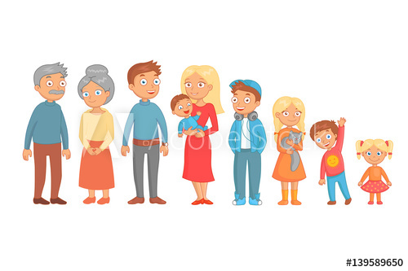

Slide 4
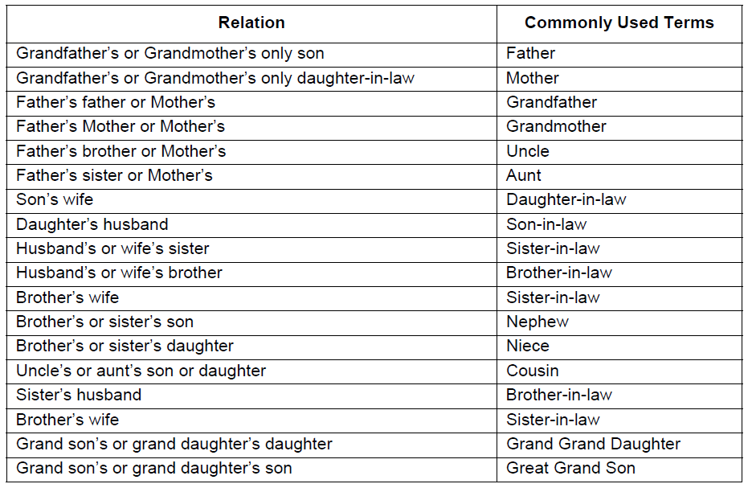

Slide 5

1
2
-
-
-
-
-
Conditions 1-2
In a family of 3 generations, there are two couples and two pairs of brothers and sisters. We also know that,
-Neeta is the sister-in-law of Leena
- Geeta is the daughter of Jai
- Jyotsna and Rajesh is the eldest couple in the family
- Jagdish is the son of Leena
- Jai is the son of Rajesh and his wife is Leena.
Notes:
View→ Notes page

Slide 6
Question 1
Leena is the --------- of Rajesh?
Notes:
Daughter-in-law

Slide 7
Question 2
Who is aunt of Jagdish?
Notes:
Neeta

Slide 8
Question 3
On a seeing a photograph of a boy, a man said, “ He is the son of the only son of my mother.” How is the man related to that boy?
Notes:
Father

Slide 9
Question 4
Rama told Lakshmana, “ Yesterday, I met the only brother of the daughter of my grandmother.” Whom did Rama meet?
Notes:
Father or uncle ( can’t be determined)
Because the only brother mentioned can be either Rama’s father or his uncle.

Slide 10
Question 5
Pointing to a photo, Mr. Bean said: “ I have no brother or sister but that fellow’s father is my father’s son. Whose photo is it?
Notes:
Mr. Bean’s son

Slide 11
Question 6
In Mr. Mehta’s family, there are
1- grand father
1- grand mother
2 -fathers
2 - mothers
1 - father-in-law
1- mother-in-law
4- children
3- grand children
1- brother
2- sisters
2- sons
2 – daughters
1 – daughter-in-law
How many members are there in Mr. Mehta’s family?
Notes:
7 members

Slide 12
Question 7
If A + B means A is the mother of B,
A – B means A is the brother of B,
A % B means A is the father of B,
A x B means A is the sister of B.
Which of the following shows that P is the maternal uncle of Q?
A) Q – N + M x P
B) P + S x N –Q
C) P – M + N x Q
D) Q – S % P
Notes:
Options C

Slide 13
Question 8
Looking at a portrait of a man, Rajanikanth said, "his mother is the wife of my father's son. Brothers and sisters I have none." At whose portrait was Rajanikanth looking?
A)
His son
B)
His cousin
C)
His uncle
D)
His nephew
Notes:
. His son
Justification: Since Rajanikanth has no brother or sister, so he is his father's only son. Now, wife of my father's son -- my wife. So, Rajanikanth's wife is the man's mother or the man is Rajanikanth's son.

Slide 14
Question 9
In a family, CO is the daughter of TO’s father’s only brother OK. MO is the only son of BO and brother of TO. PO is the sister of OK. NO is the mother of CO. BO is not the aunt of CO. Who is the sister of BO?
A)
CO
B)
NO
C)
TO
D)
PO
Notes:
Option D

Slide 15
Question 10
A woman, pointing towards a man said, “He is my mother’s mother’s only son”. How is the woman related to the man?
A)
Cousin
B)
Mother
C)
Niece
D)
Aunt
Notes:
Option C

Slide 16
Question 11
P x Q means P is the sister of Q; P + Q means P is the father of Q; P - Q means P is the mother of Q. Which of the following means S is the aunt of T?
A)
Cousin
B)
Mother
C)
Niece
D)
Aunt
Notes:
Option C

Slide 17
12
13
-
-
-
-
-
Conditions 12-13
Rajinder and Surinder are the sons of Mrs. And Mr. Maudgil.
- Seeta is the sister of Surinder
- Renu, Raja and Sunil are children of Mrs. And Mr. Bhaskar
- Sunil and Seeta are married and Ashok and Sanjay are their children
- Geeta and Rakesh are children of Mrs. And Mr. Jain
- Geeta is married to Surinder and has three children named Rita, Sonu and Raju.

Slide 18
Conditions
Question 12
How is Rajinder related to Raju?
Notes:
Paternal uncle

Slide 19
Conditions
Question 13
How is Rajinder related to Ashok?
Notes:
Maternal uncle

Slide 20
Question 14
Pointing to a girl in the photograph, Amar said, "Her mother`s brother is the only son of my mother's father." How is the girl`s mother related to Amar?
A. Mother
B. Sister
C. Aunt
D. Grandmother
E. None of these
Notes:
Answer: E. None of these.
Justification: Only son of Amar's mother's father -- Amar's maternal uncle. So, the girl's maternal uncle is Amar's maternal uncle. Thus, the girl's mother can be Amar’s mother or Amar's aunt.
So our answer is option E.

Slide 21
Question 15
If X is the brother of the son of Y`s son, how is X related to Y?
A. Son
B. Brother
C. Cousin
D. Grandson
E. Uncle
Notes:
Answer: D. Grandson
Justification: Son of Y's son -- Grandson; Brother of Y's grandson -- Y's grandson.

Slide 22
Question 16
Pointing to a gentleman, Deepak said, " His only brother is the father of my daughter`s father." How is the gentleman related to Deepak?
A. Grandfather
B. Father
C. Brother-in-law
D. Uncle
E. Cannot be determined
Notes:
Answer: E: Cannot be determined.
Justification: Father of Deepak's daughter's father -- Deepak's father. So, the man's brother is Deepak's father or the man is the brother of Deepak's father i.e., Deepak's uncle.
Or, if we consider Deepak as a female then she is the wife of gentlemen’s brother’s Son. In this case the relationship will be Father-in-law’s brothers.
So for the same question we are getting two answers, hence we cannot determine the answer.

Slide 23
Question 17
In a family of six persons A, B, C, D, E and F, there are two married couples. D is grandmother of A and mother of B. C is wife of B and mother of F. F is the granddaughter of E.
Who among the following is a couple, according to the given data? A. CD
B. DE
C. EB
D. Cannot be determined
E. None of these
Notes:
Answer: B. DE
Justification: C is wife of B. So, one couple is BC. Now, D is grandmother of A. B is the son of D and his wife C is the mother of F. So, D is also the grandmother of F. But F is the granddaughter of E. So, E is the grandfather of F and the husband of D. Thus, DE is another couple.

Slide 24
Question 18
Each of these questions is based on the following information: 1. M % N means M is the son of N. 2. M @ N means M is the sister of N. 3. M $ N means M is the father of N. Which of the following shows the relation that C is the granddaughter of E? A. C % B $ F $ E
B. B $ F $ E % C
C. C @ B % F % E
D. E % B $ F $ C
Notes:
Answer: Option C
Explanation:
C @ B → C is the sister of B
B % F → B is the son of F
Hence, → C is the daughter of F
F % E → F is the son of E
Hence, → C is the granddaughter of E.

Slide 25
Question 19
(i) In a family of six persons A, B, C, D, E and F, there are two married couples. (ii) D is grandmother of A and mother of B. (iii) C is wife of B and mother of F. (iv) F is the granddaughter of E. How many male members are there in the family? A. Two
B. Three
C. Four
D. Cannot be determined
E. None of these
Notes:
Answer: D. Cannot be determined
Justification: Clearly, the sex of A cannot be determined.

Slide 26
Question 20
P + Q means P is the brother of Q; P - Q means P is the mother of Q and P * Q means P is the sister of Q. Which of the following means M is the maternal uncle of R? A. M + K + R
B. M - R + K
C. M + K - R
D. M + K * R
E. None of these
Notes:
Answer: C. M + K - R
Justification: M is the maternal uncle of R means M is the brother of the mother (say K) of R i.e. M + K - R.

Slide 27

THANK YOU
Notes:
Thank you slide

